Slide 1

Complex numbers
Zdzisław Papir
Institute of Telecommunications
www.agh.edu.pl

Slide 2
Algebraic form of complex number
imaginary unit
real part
imaginary part

Slide 3
Vector representation on a complex plane
vector
Im{·}
z = a + ib = (a, b)
b
i
a
1
Re{·}

Slide 4

Example
Equilateral triangle
side = 1

Slide 5
Conjugation of complex number
Im{·}
z = a + ib = (a, b)
b
i
a
1
Re{·}
z* = a - ib = (a, -b)

Slide 6
Example

Slide 7
Summation of complex numbers (vector representation)
Im{·}
z + u
u
z
a
c
Re{·}
Summation of complex numbers = adding vectors

Slide 8
Multiplication of complex numbers
Multiplication of complex numbers = multiplication of polynomials, i² = -1)

Slide 9
Division of complex numbers
Division of complex numbers = multiplication of complex numbers + conjugation of a denominator

Slide 10
Example

Slide 11
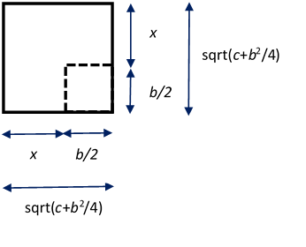
When did imaginary unit and complex numbers appear ?
Solutions to problems that can be expressed in terms of quadratic equations were known as early as 2000 BC (by completing the square).
Quadratic equations emerged in Europe only in XII century.
If discriminant („delta” - ∆) was negative, c + b²/4 < 0, then the solutions were called „impossible” or „absurd”).

Slide 12
When did imaginary unit and complex numbers appear ?
Breakthrough XVI c. – Italians: del Ferro, Tartaglia, and lastly Ferrari, Cardano, Bombelli found that cubic equation has a root given by formula:
Similar formulas Italians found for quartic equations.
Examples:

Slide 13
When did imaginary unit and complex numbers appear ?
Italian Bombelli investigated a specific cubic equation:
Bombelli applied all rules for transformation of algebraic expressions (however, assuming i² = -1) and was able to find that:
This way complex numbers like a + bi were born (i² = -1).

Slide 14
Amazement #1 (do we need „more complex” numbers?)
Polynomial equations of 2nd, 3rd and 4th degree possess complex (or real) roots.
Remark: we do not need to design complex numbers „more complex” then a +ib as the degree of the polynomial equation
is increased, n > 2.
Gauss (1799) proved Fundamental Theorem of Algebra –
roots of polynomial equations are complex
no matter the polynomial degree is (n > 4).

Slide 15
Amazement #2 (do closed formula for polynomial roots exist?)
Polynomial equations of the 2nd, 2rd and 4th degree have roots expressed by so called „radicals” – algebraic expressions made of numbers, four basic arithmetic operations ( +, -, x, / ) and nested roots.

Slide 16
Amazement #2 (do closed formula for polynomial roots exist?)
XVI c. – XIX c. – 300 years of a continuous quest for radical expressions
for roots of polynomial equations of the 5th and higher degree.
At the turn of XVIII c. i XIX c. – Ruffini, Abel and lastly Galois proved that closed form expressions for polynomial roots do not exist for poly- nomial equations of the 5th and higher degrees (in a general case).

Slide 17
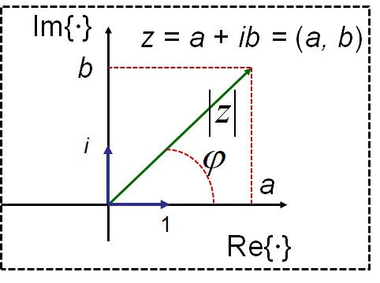
Trigonometric form of complex numbers

Slide 18
Exponential form of complex numbers (Euler’s formula)

Slide 19
Example (proof of Euler’s formula)

Slide 20
Most Beautiful Mathematical Formula Ever

Slide 21
Example (two other Euler’s identities)

Slide 22
de Moivre formula
(exponentiation, n integer)

Slide 23
de Moivre formula
(root extraction, n integer)

Slide 24
Example

Slide 25
Multiplication of complex numbers (vector representation)
Im{·}
Multiplication of complex numbers: multiplication of vector lenghts + + adding vector angles
Re{·}
Multiplication of complex numbers (vectors) yields a vector placed on the plane (Re, Im). Other multiplication rules (dot product, vector or mixed product)) do not match this requirement.

Slide 26
Example

Slide 27
Amazement #3
(why is the multiplication of complex numbers so sophisticated?)
Answer: both multiplication rules are equivalent.
Remark - law of moduli:
Modulus of a product of two numbers is equal to a product of moduli of these numbers.

Slide 28
Amazement #3 (why is the multiplication of complex numbers so sophisticated?)
Why complex numbers aren’t multiplied in the same manner as they are added?
For the „yellow” definition it is not possible to find the multiplicative inverse.
For inquirers only: multiplicative inverse is one of conditions to form a field of complex numbers.

Slide 29
Example
(law of moduli)
Prove the law of moduli:
Modulus of a product of two numbers is equal to a product of moduli of these numbers.

Slide 30
Amazement #4 (is it possible to extend complex numbers from the plane R² to the space R³?)
z = (a, b, c) = a + ib + jc
Im{·}
z = (a, b) = a + ib
b
i
j
a
i
1
1
Re{·}
Complex numbers
(2-tuples) (plane R²)
Triplets (3-tuples)
(space R³)

Slide 31
Amazement #4 (is it possible to extend complex numbers from the plane R² to the space R³?)
Multiplication of triplets:
z = (a, b, c) = a + ib + jc
u = (d, e, f) = d + ie + jf
zu = (a + ib + jc)(d + ie + jf)
needs answering a question how much is:
ij = ? or ji = ?
It appears that no matter what you assume (ij = +1, ij = -1 etc), multiplication of triplets (performed in the same way as multiplication of complex numbers) does not preserve the law of the moduli.

Slide 32
Hamilton’s quaternions (1843)
Hamilton discovered quaternions as 4-tuples
z = (a, b, c, d) = a +ib + jc + kd
under following rules for multyplying versors:
i² = j² = k² = -1
ij = k, jk = i, ki = j
ji = -k, kj = -i, ik = -j
Quaternions obey the law of the moduli but quaternionic multiplication is noncommutative zv ≠ vz.
z – a = ib + jc + kd
Quaternions are used in mechanics and computer graphics to easily model
rigid body rotations in the space R³.
k
j
i

Slide 33
Octonions
Beyond quaternions, there is one more field with multiplicative inversion: the octonions. They are constructed using seven imaginary units. In addition to being noncommutative, octonion multiplication is also nonassociative: in general, (uv)z ≠ u(vz).
There are only for algebraic fields with multiplicative inversion:
real numbers – order, associativity/commutativity
complex numbers – order of numbers is lost
quaternions – commutativity of multiplication is lost
octonions – associativity of multiplication is lost

Slide 34
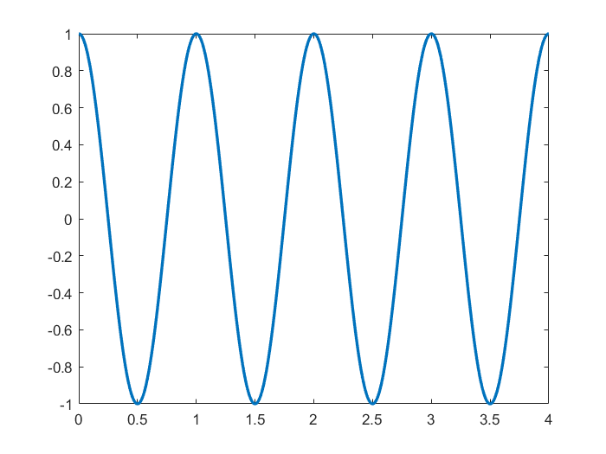
Phasor diagrams
Im{·}
Re{·}
www.agh.edu.pl

Slide 35
Phasor diagrams
Im{·}
Im{·}
Re{·}
Re{·}
www.agh.edu.pl

Slide 36
Phasor diagrams
(amplitude and phase changing with time)
Im{·}
Re{·}
www.agh.edu.pl

Slide 37
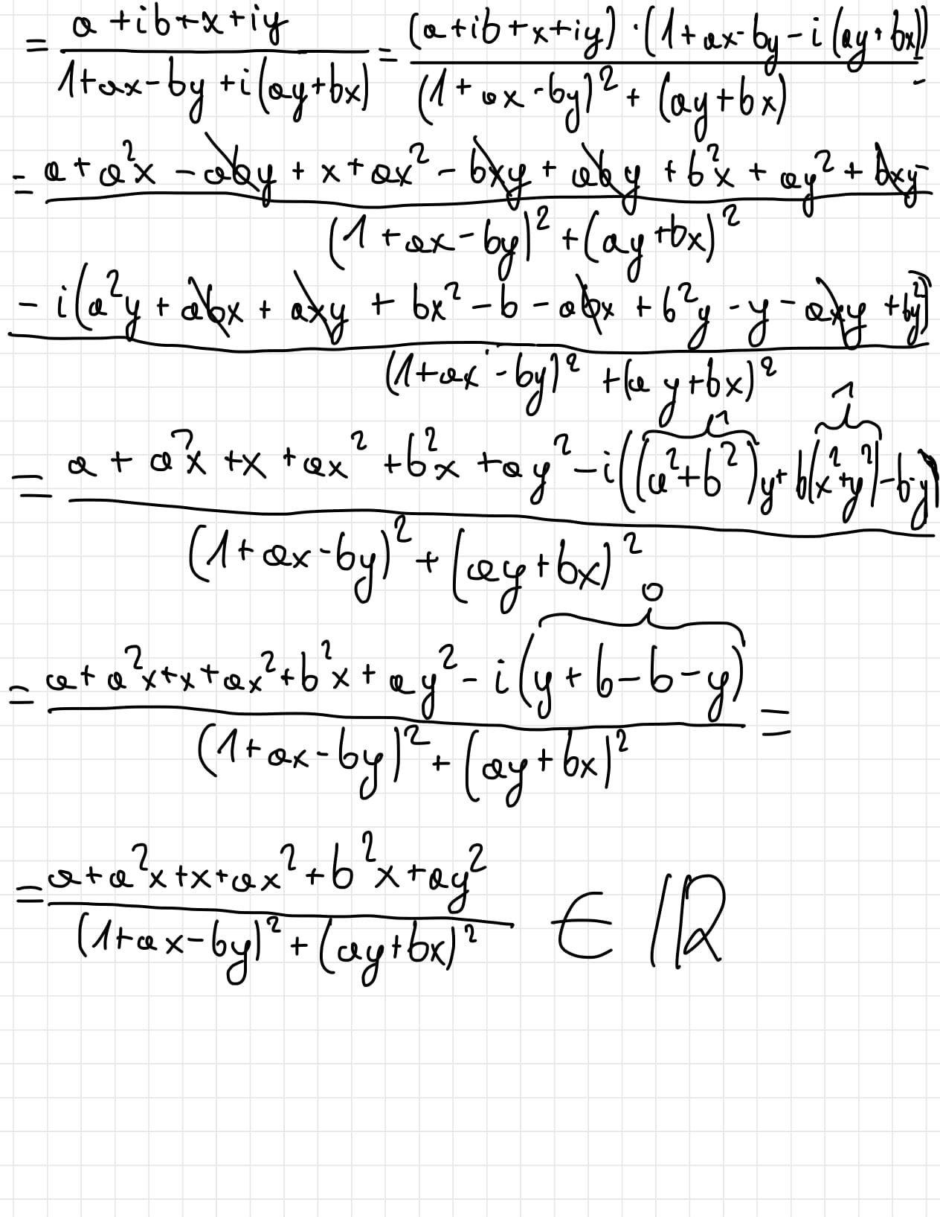
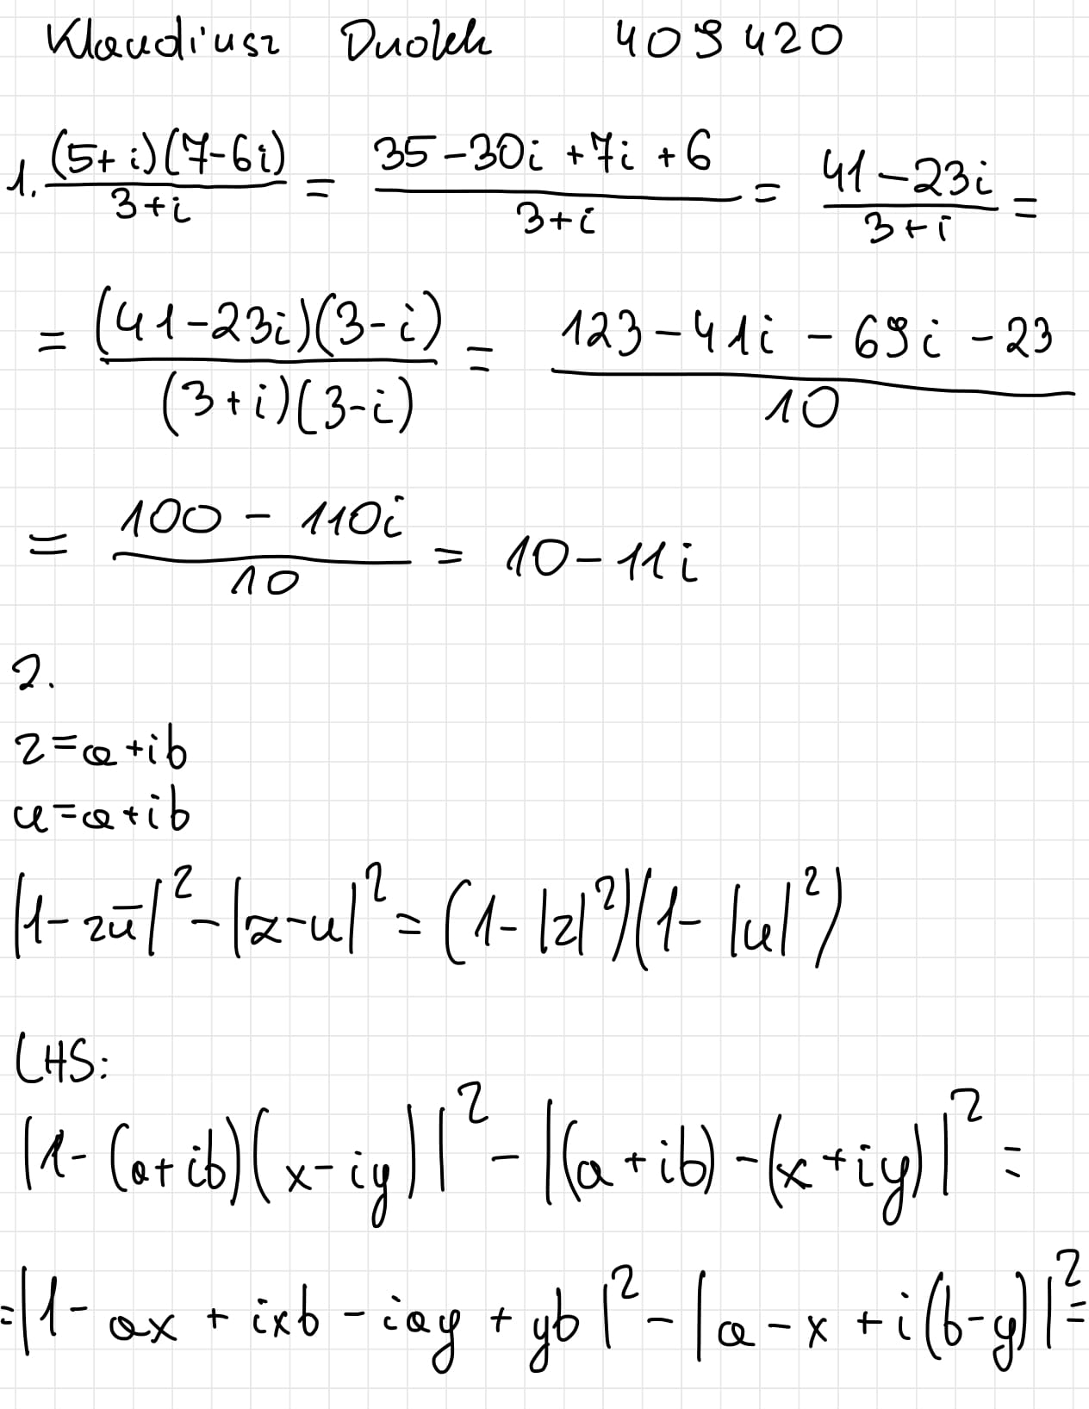
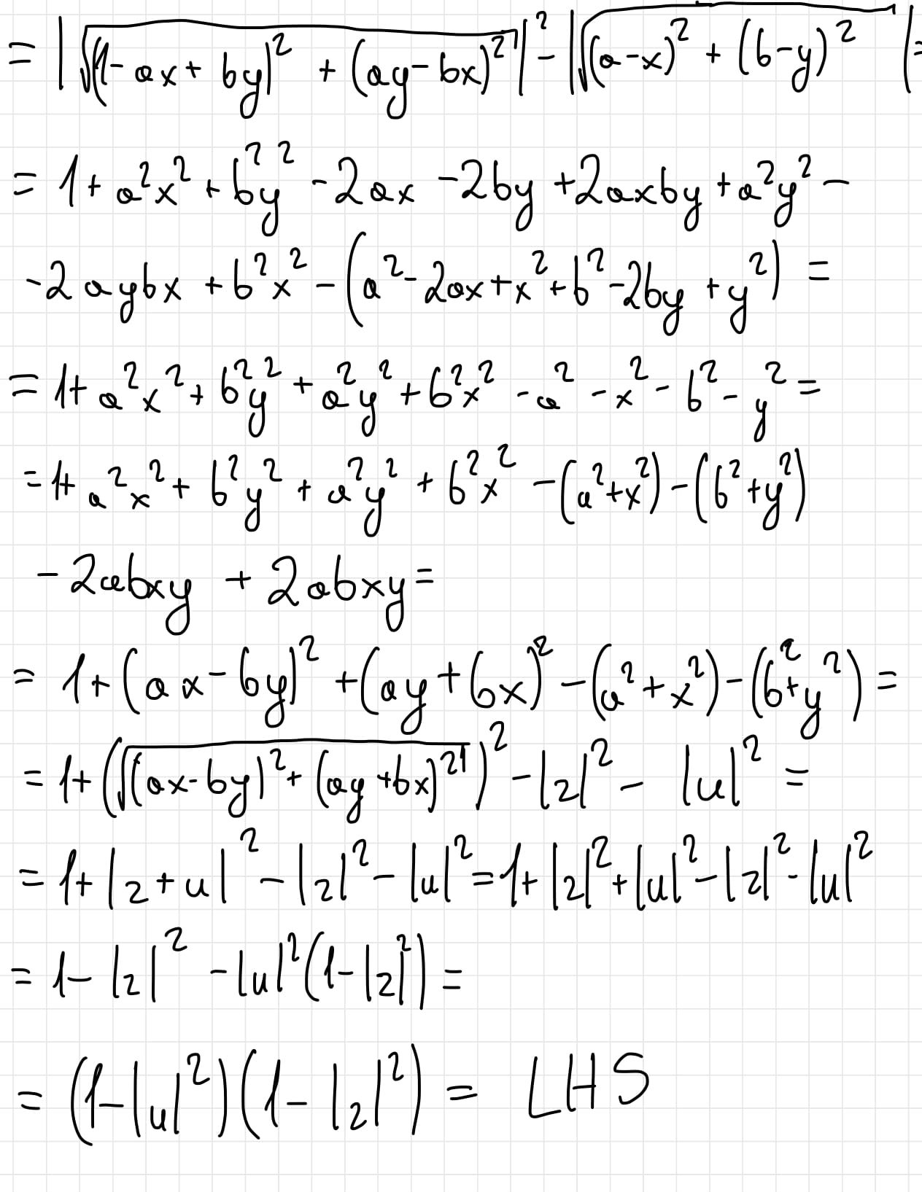
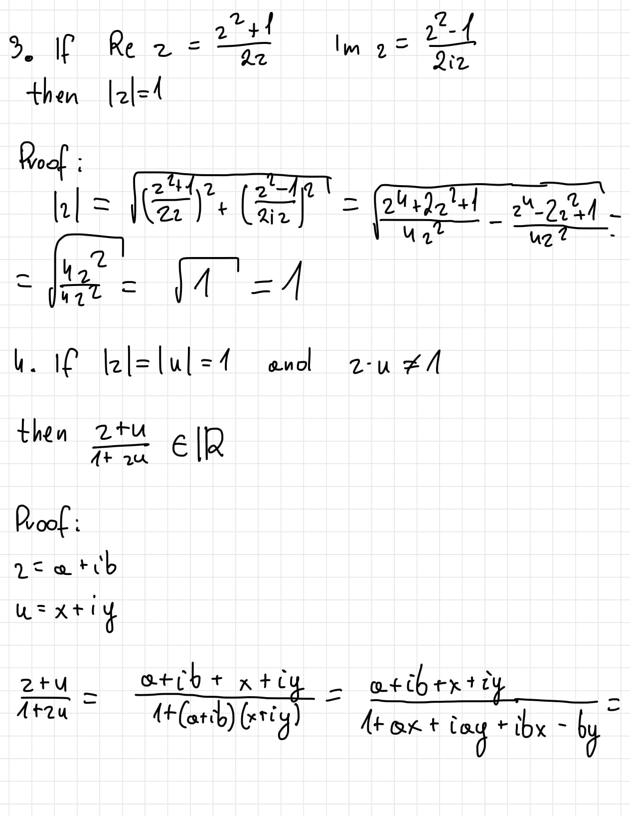

Slide 42
